Slide 1
Bill Liu Software IT Intern

Slide 2
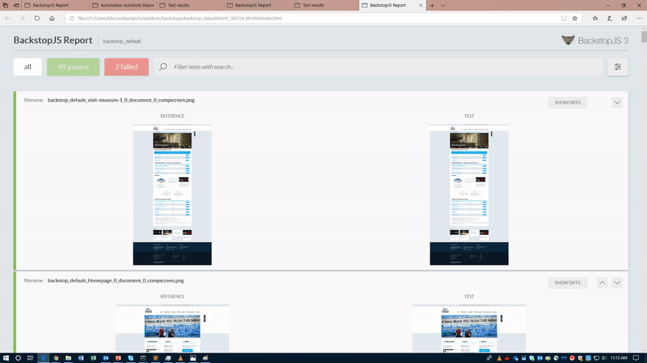
Project: Test Automation System
Abstract: Implement fully automated testing suites to ensure the functionality and user acceptability of critical web pages on 911memorial.org

Slide 3
Project: Test Automation System
Abstract: Implement fully automated testing suites to ensure the functionality and user acceptability of critical web pages on 911memorial.org

Slide 4
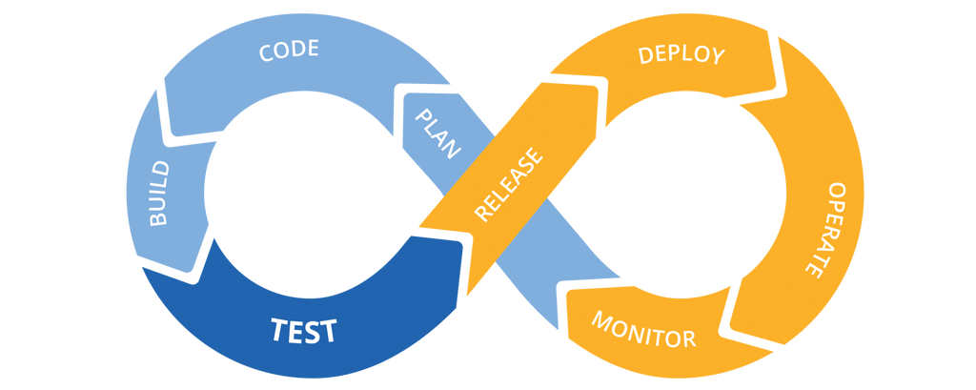
What is Test Automation?
Test Automation is a system of software that control and execute test suites then report on the outcome
Automates repetitive but necessary tasks
A critical part of continuous integration because our website and applications are constantly updating

Slide 5
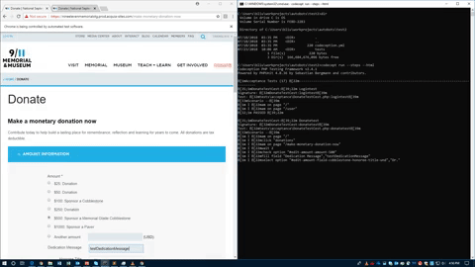
Why Test Automation
Provide real-time and scheduled(every day) reassurance that our web pages and functions are working properly
For Example: Make Donation page and membership join page
Significantly reduce the amount of time the developer team spends on testing functionalities
Eliminate the need for the developer team to manually check existing web pages for unexpected changes
Do all of the above with NO click of a button!

Slide 6







Contractors Sending in Their Bids
Many possible directions to take to achieve test automation goal
Numerous similar technologies and services available
Select the best available tools that fit our needs the most

Slide 7
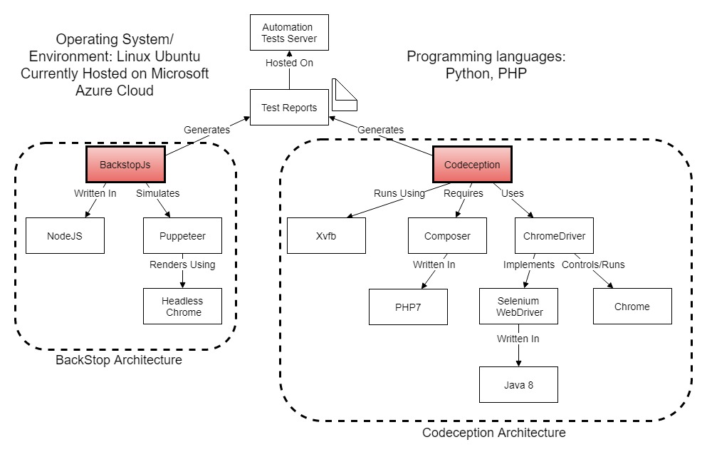
2 Approaches: User Acceptance Tests and Visual Regression Tests

Slide 8
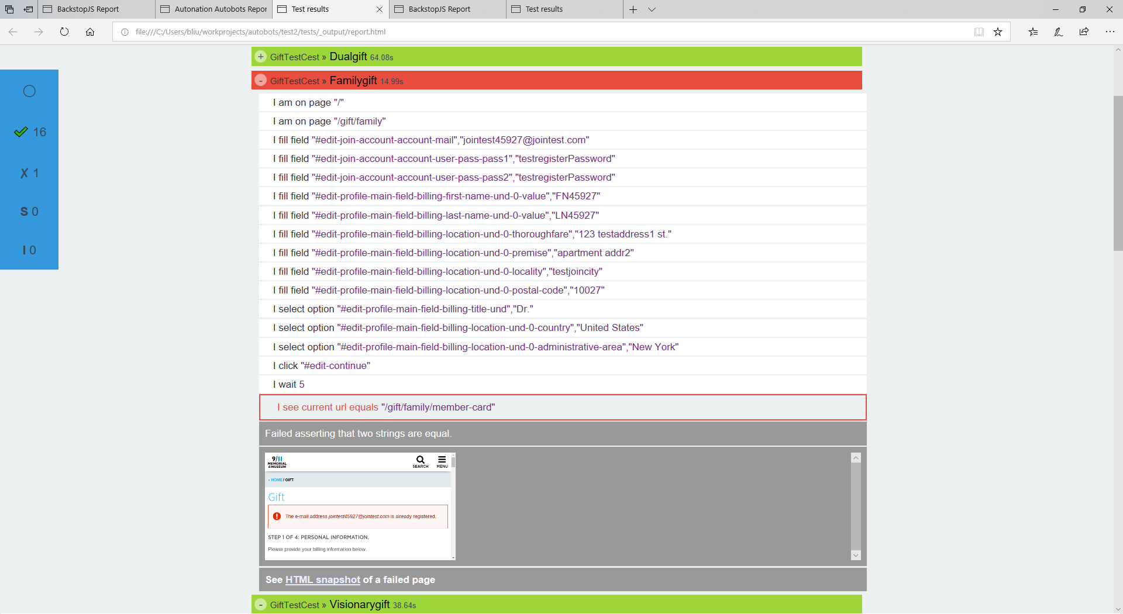

User Acceptance Tests Catching Errors
Codeception is a full stack testing framework written in PHP
Can automatically control your web browser to perform certain tasks on websites such as:
Filling out forms
Creating assertions
Interacting with dynamic content
Generates reports that report any errors in the execution and provides snapshots of where the error occurred

Slide 9
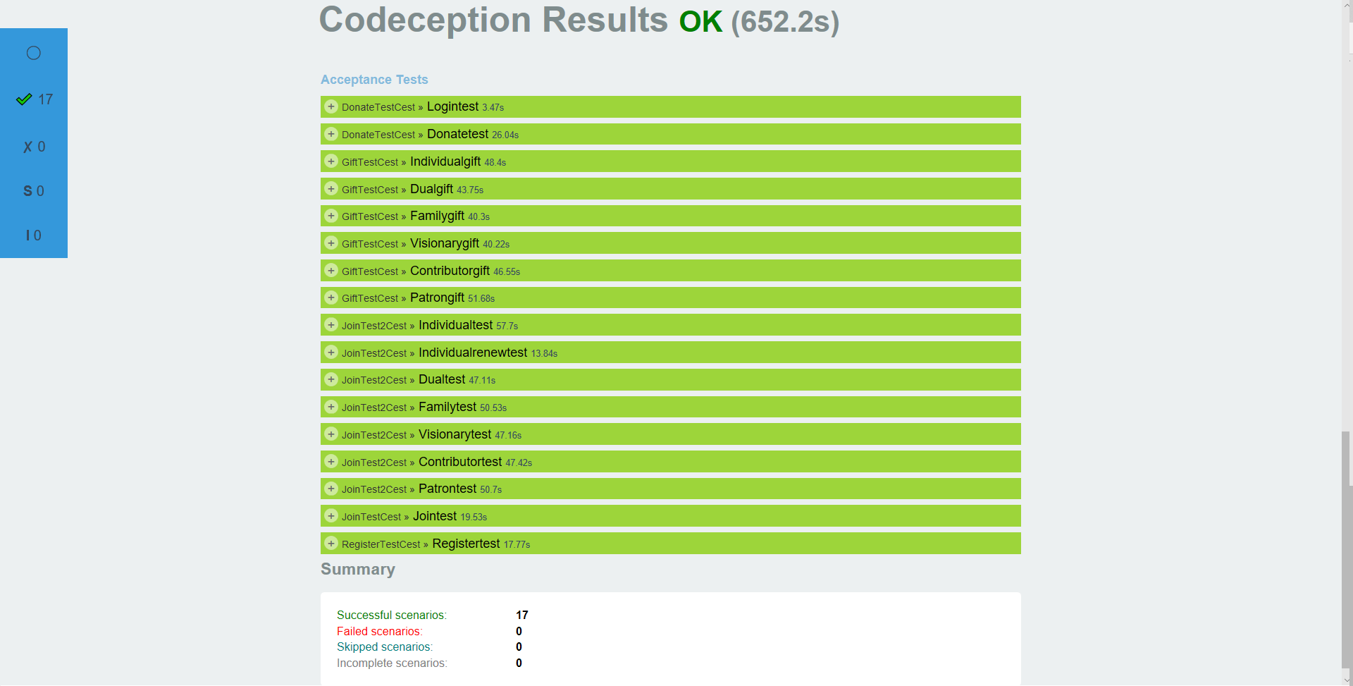
User Acceptance Tests Report
Example of report showing a successful test run

Slide 10
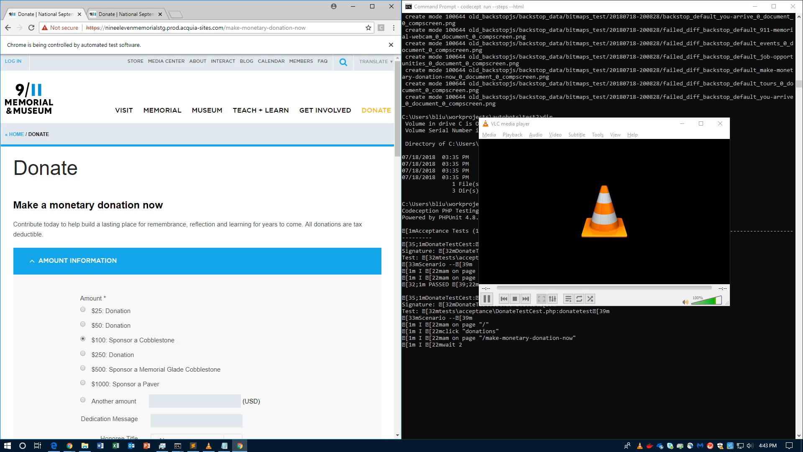
User Acceptance Tests Video

Slide 11
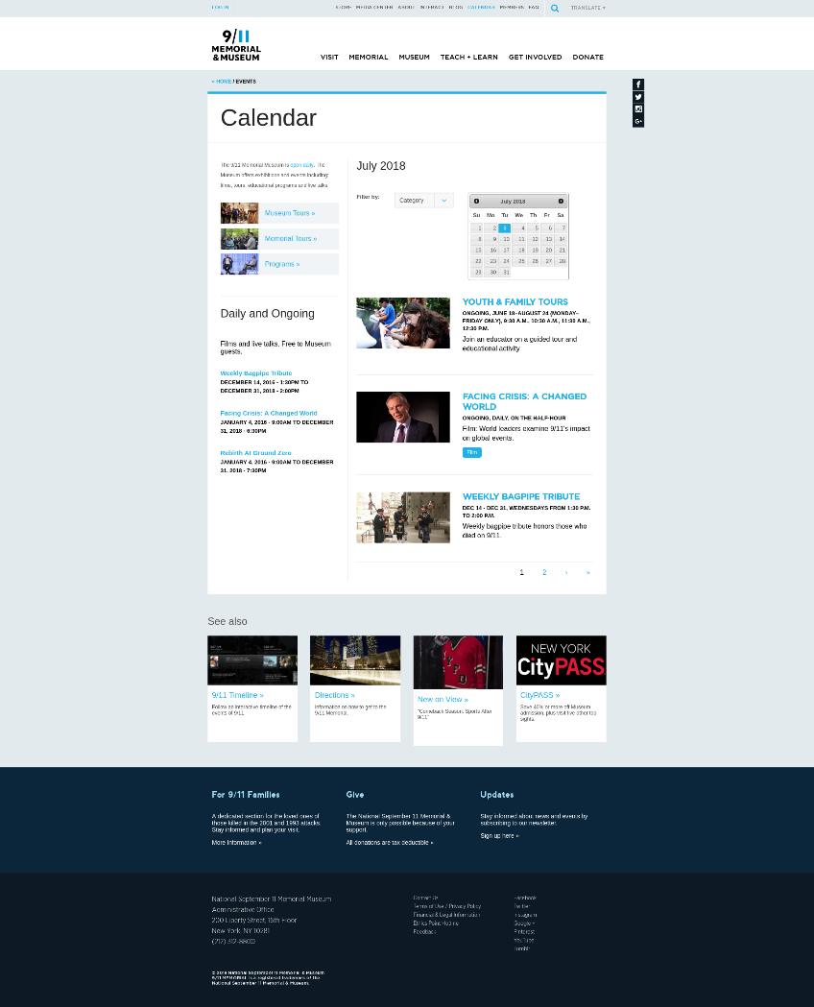
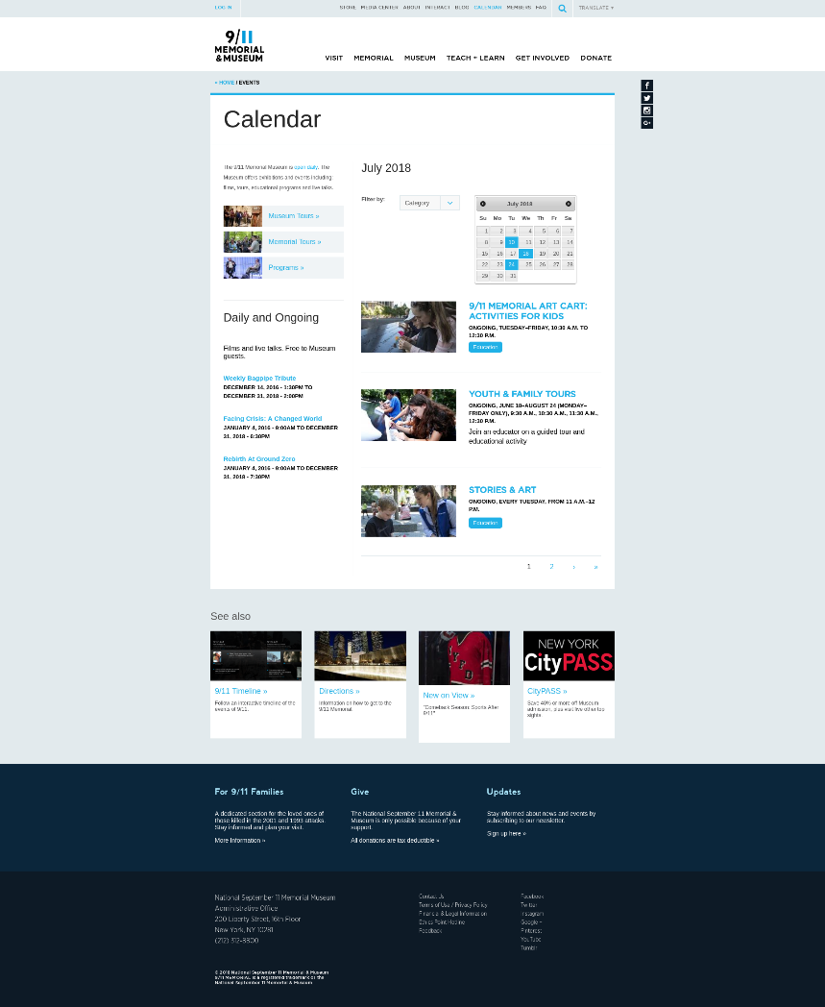
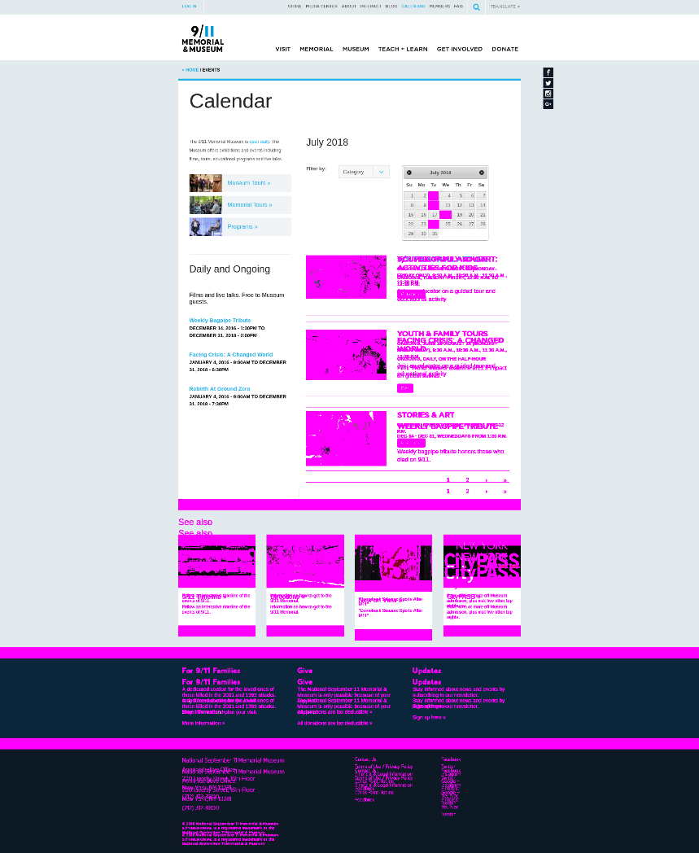
Visual Regression Tests Report
Before/Reference
New Test Run
Web Page Differences

Slide 12
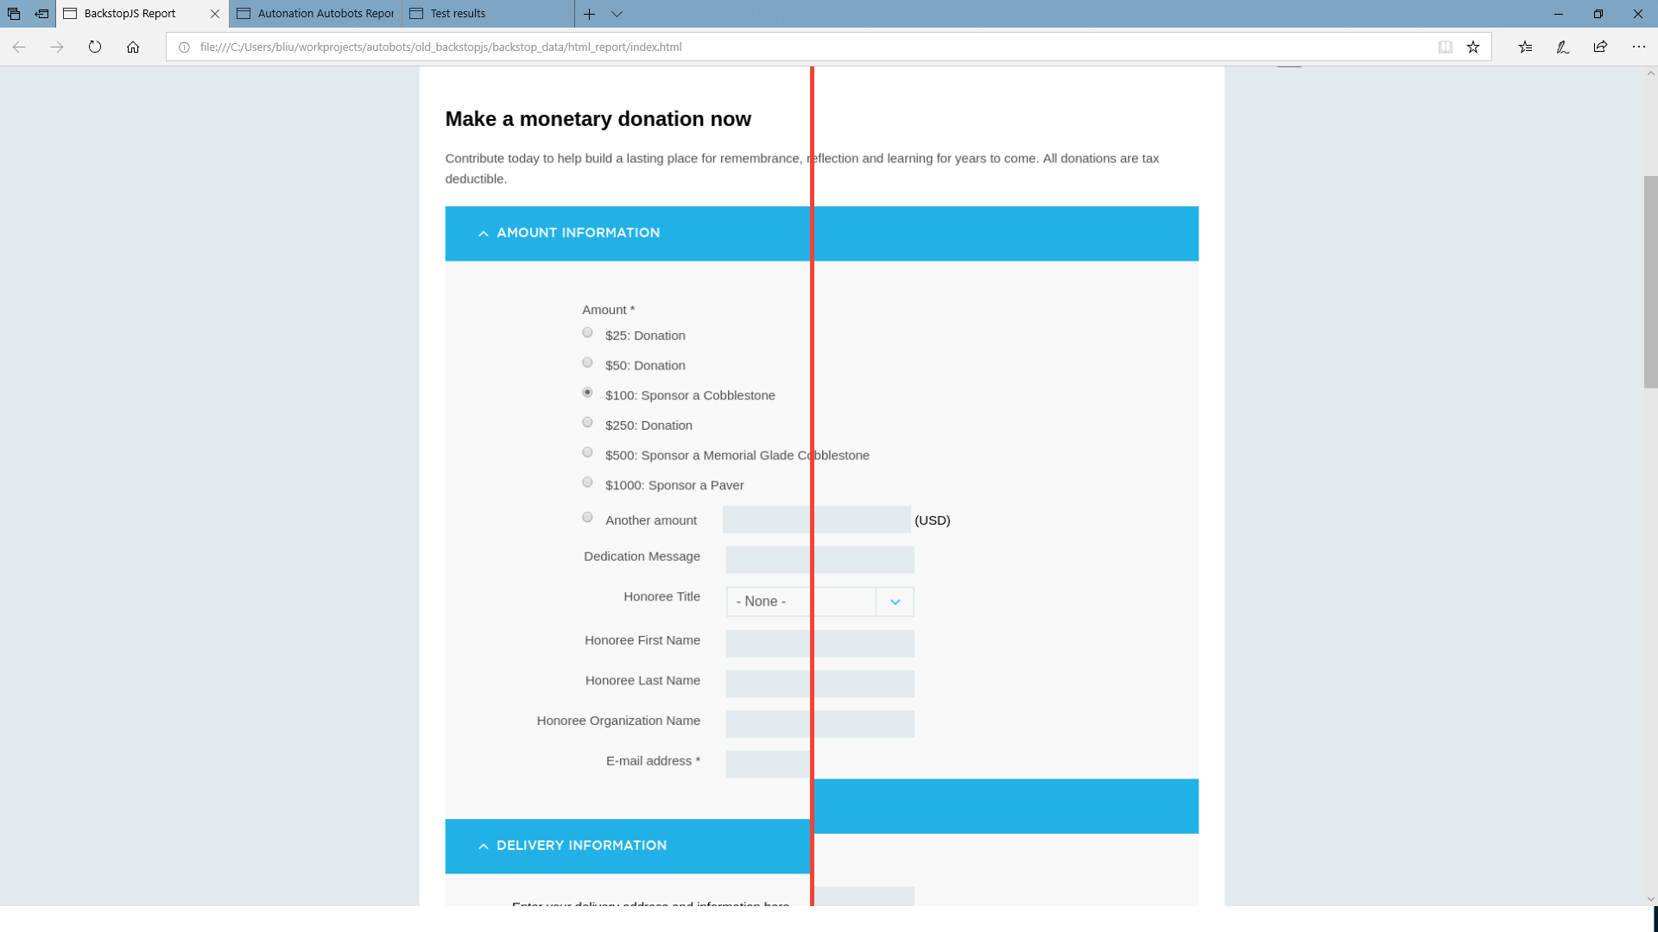
Visual Regression Tests Scrubber

Slide 13
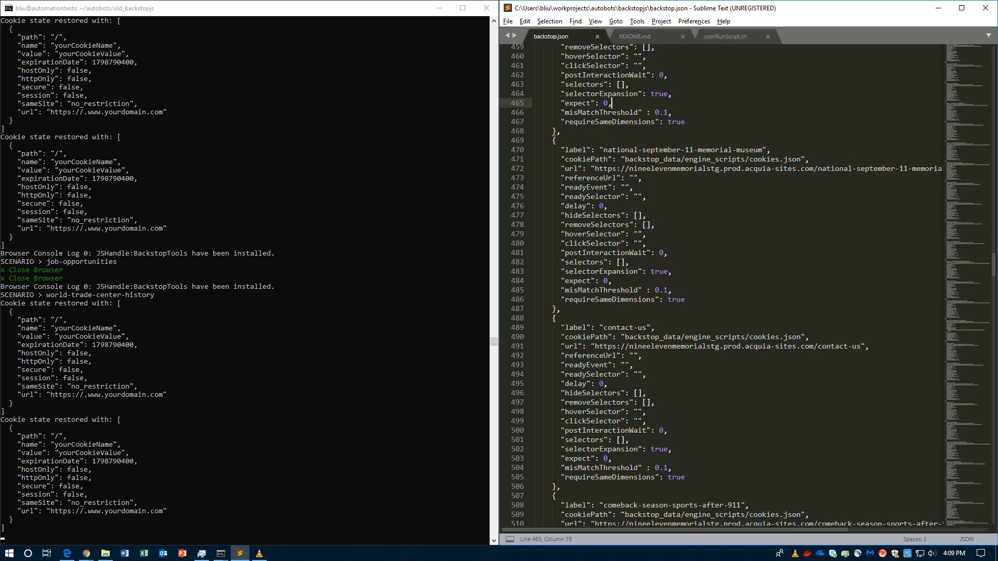
Visual Regression Tests Video

Slide 14
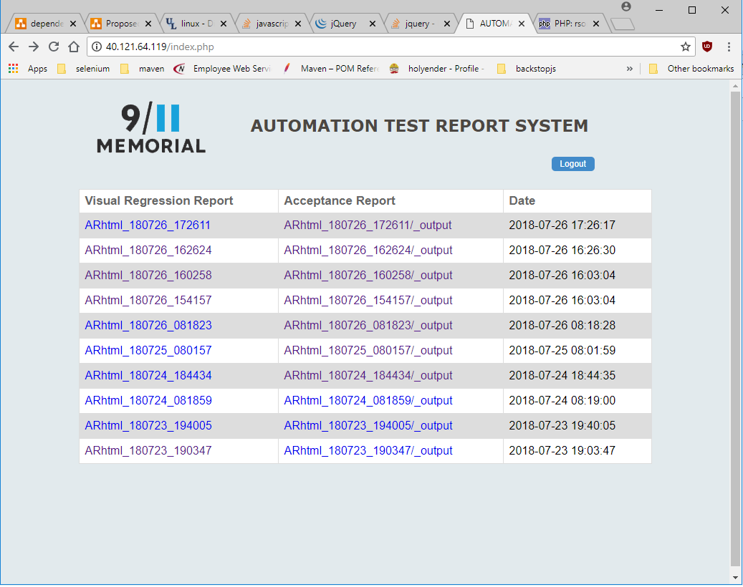
Apache2 Webpage
Simple website that shows both Codeception and Backstop reports along with the time stamp
Keeps a record of the test results of our website
Once again. Done with No Click of A Button!!

Slide 15
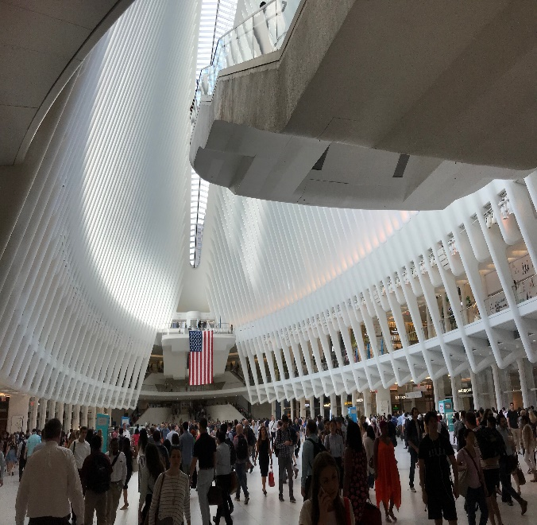
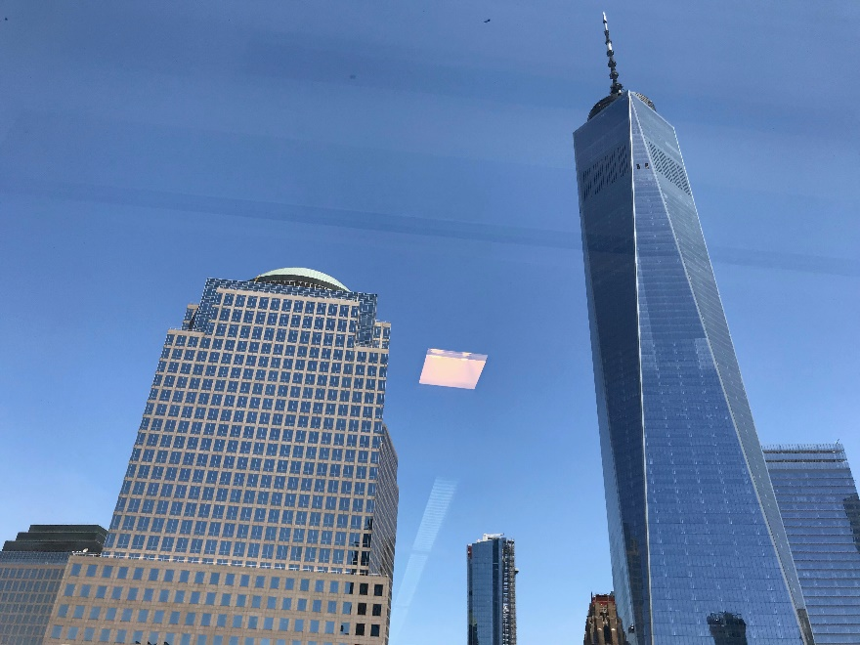

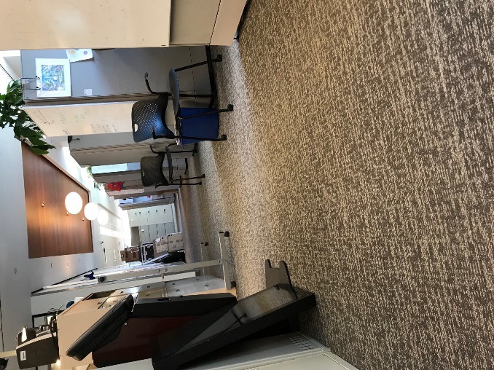


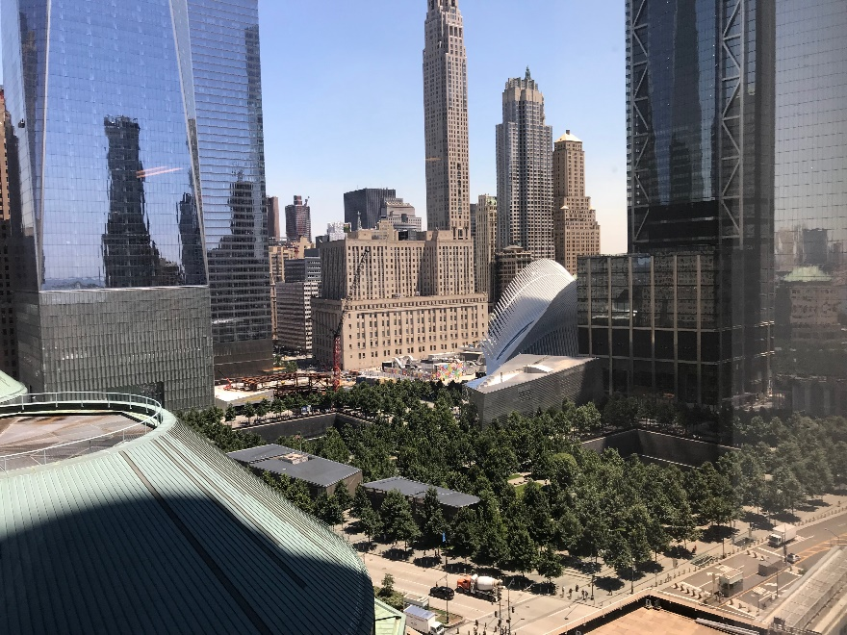
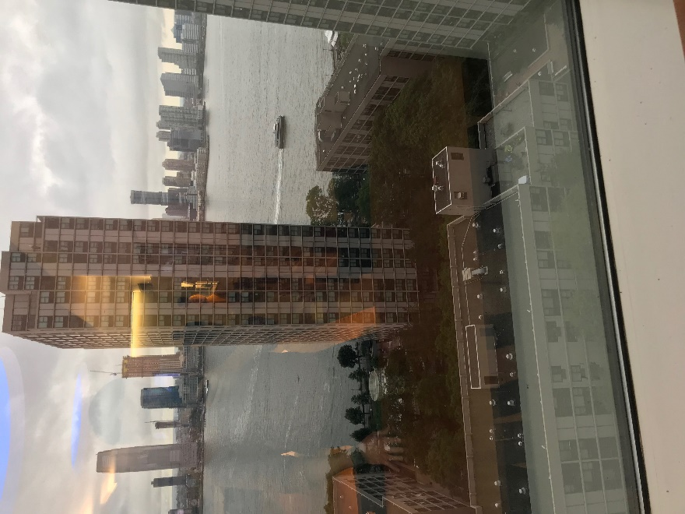
Summary

Slide 16

Thank You!

